Slide 1

ECE 2001 Basic Circuit Theory
Lecture 11
Fourier Transform vs. Laplace Transform

Slide 2
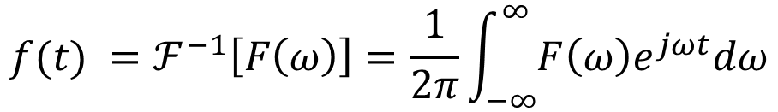
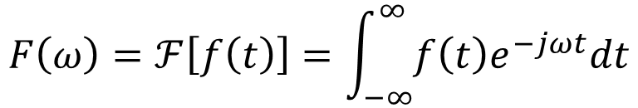
Fourier transform pair:
The Fourier transform is an integral transform of f(t) from the time domain to the frequency domain.
In general, F(ω) is a complex function.
Its magnitude is called the amplitude spectrum. The phase is called the phase spectrum.
Inverse Fourier transform:
$$F\left(ω\right)=ℱ\left[f\left(t\right)\right]=\int_{−∞}^{∞}{f\left(t\right)e^{−jωt}dt}$$
$$f(t) =ℱ^{−1}\left[F\left(ω\right)\right]=\frac{1}{2π}\int_{−∞}^{∞}{F\left(ω\right)e^{jωt}dω}$$

Slide 3
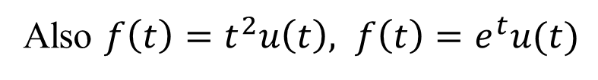
Conditions on F(ω)
The Fourier transform does not exist for all functions.
It only exists where the Fourier integral converges.
Again, a sufficient, but not necessary condition is:
An example of a function that would fail this test is the unit ramp function.
Fourier transform for $f\left(t\right)=tu\left(t\right)$ does not exist
Also $f\left(t\right)=t^{2}u\left(t\right), f\left(t\right)=e^{t}u(t)$

Slide 4

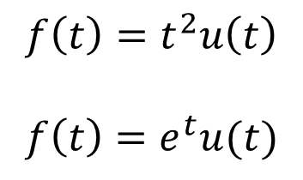
Fourier vs. Laplace
The Laplace transform we have discussed in last week is one-sided integral, in which the integral is over 0<t<∞ , making it only useful for positive time functions, f (t), t>0; The Fourier transform is applicable to functions defined for all time -∞ <t<∞.
The Laplace transform is applicable to a wider range of functions than the Fourier transform.
$$f\left(t\right)=tu\left(t\right)$$
$$f\left(t\right)=t^{2}u\left(t\right)$$
$$f\left(t\right)=e^{t}u(t)$$

Slide 5
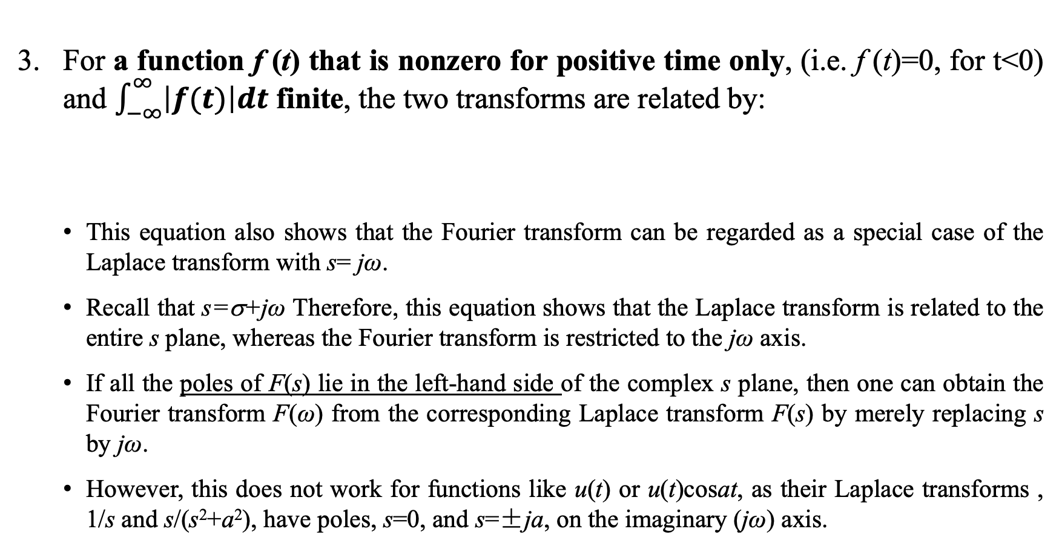
Fourier vs. Laplace II
For a function f (t) that is nonzero for positive time only, (i.e. f (t)=0, for t<0) and $\int_{−∞}^{∞}{\left|f(t)\right|dt}$ finite, the two transforms are related by:
  This equation also shows that the Fourier transform can be regarded as a special case of the Laplace transform with s= jω.
  Recall that s=σ+jω Therefore, this equation shows that the Laplace transform is related to the entire s plane, whereas the Fourier transform is restricted to the jω axis.
  If all the poles of F(s) lie in the left-hand side of the complex s plane, then one can obtain the Fourier transform F(ω) from the corresponding Laplace transform F(s) by merely replacing s by jω.
  However, this does not work for functions like u(t) or u(t)cosat, as their Laplace transforms , 1/s and s/(s²+a²), have poles, s=0, and s=±ja, on the imaginary (jω) axis.

Slide 6
Fourier vs. Laplace III
The Laplace transform is better suited for the analysis of transient problems involving initial conditions, since it permits the inclusion of the initial conditions, whereas the Fourier transform does not. The Fourier transform is especially useful for problems in the steady state.
The Fourier transform provides greater insight into the frequency characteristics of signals than the Laplace transform does.

Slide 7
Fourier Transform Pairs I

Slide 8
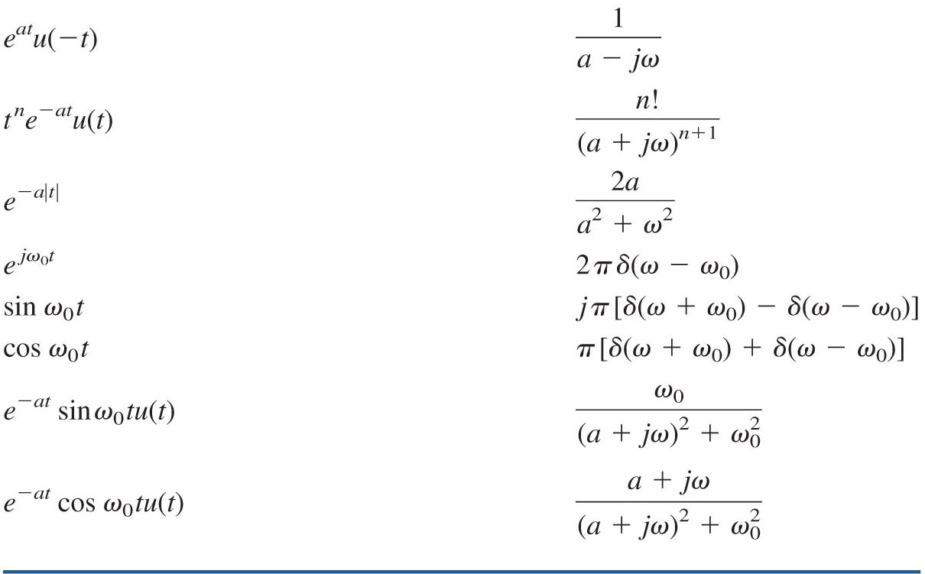
Fourier Transform Pairs II

